Slide 1
Help save us. Say NO to Genocide.

Slide 2
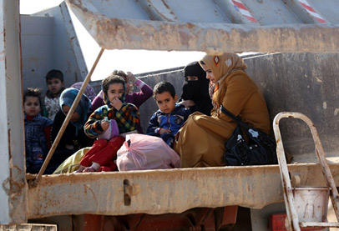
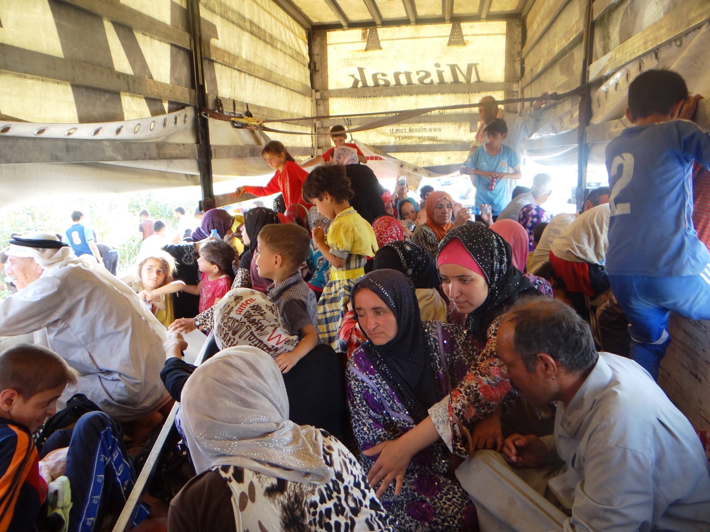
Approx 1 million turkman displaced from their homes

Slide 3
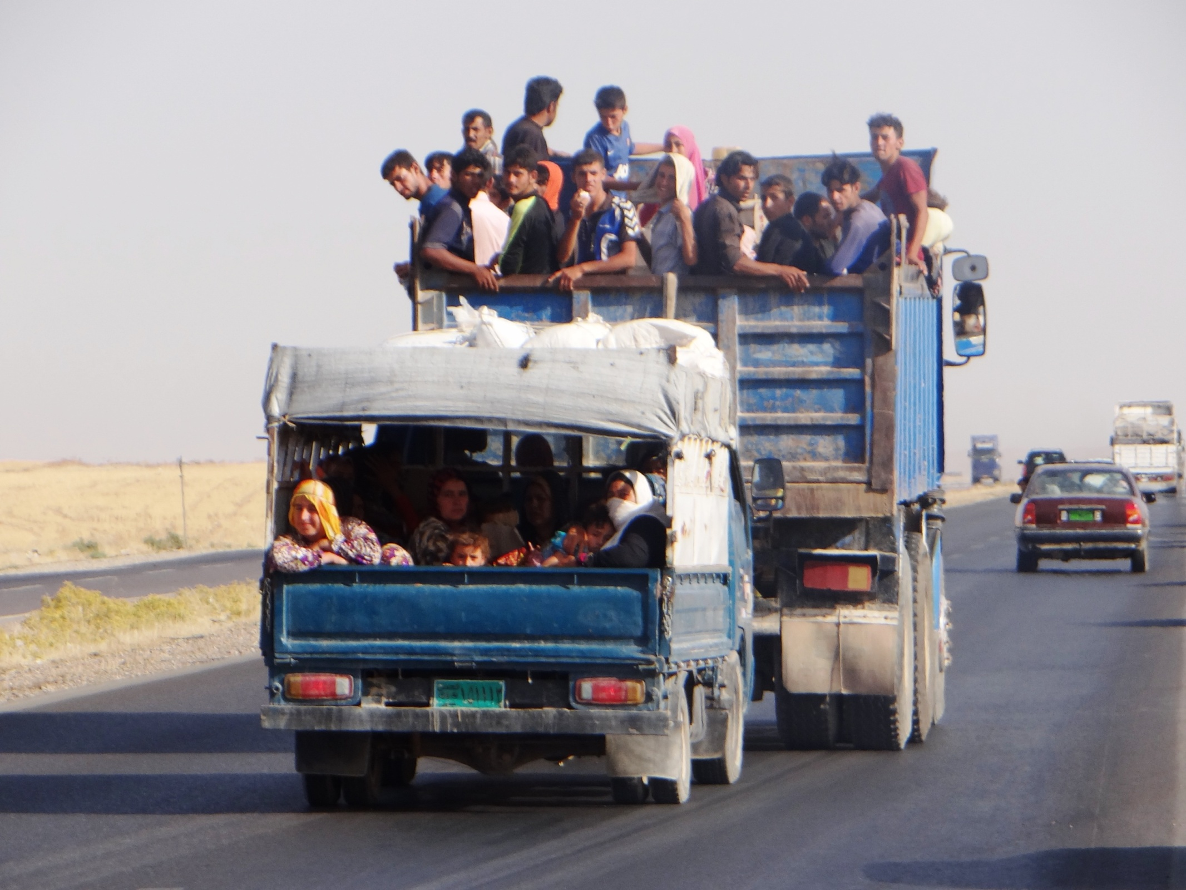
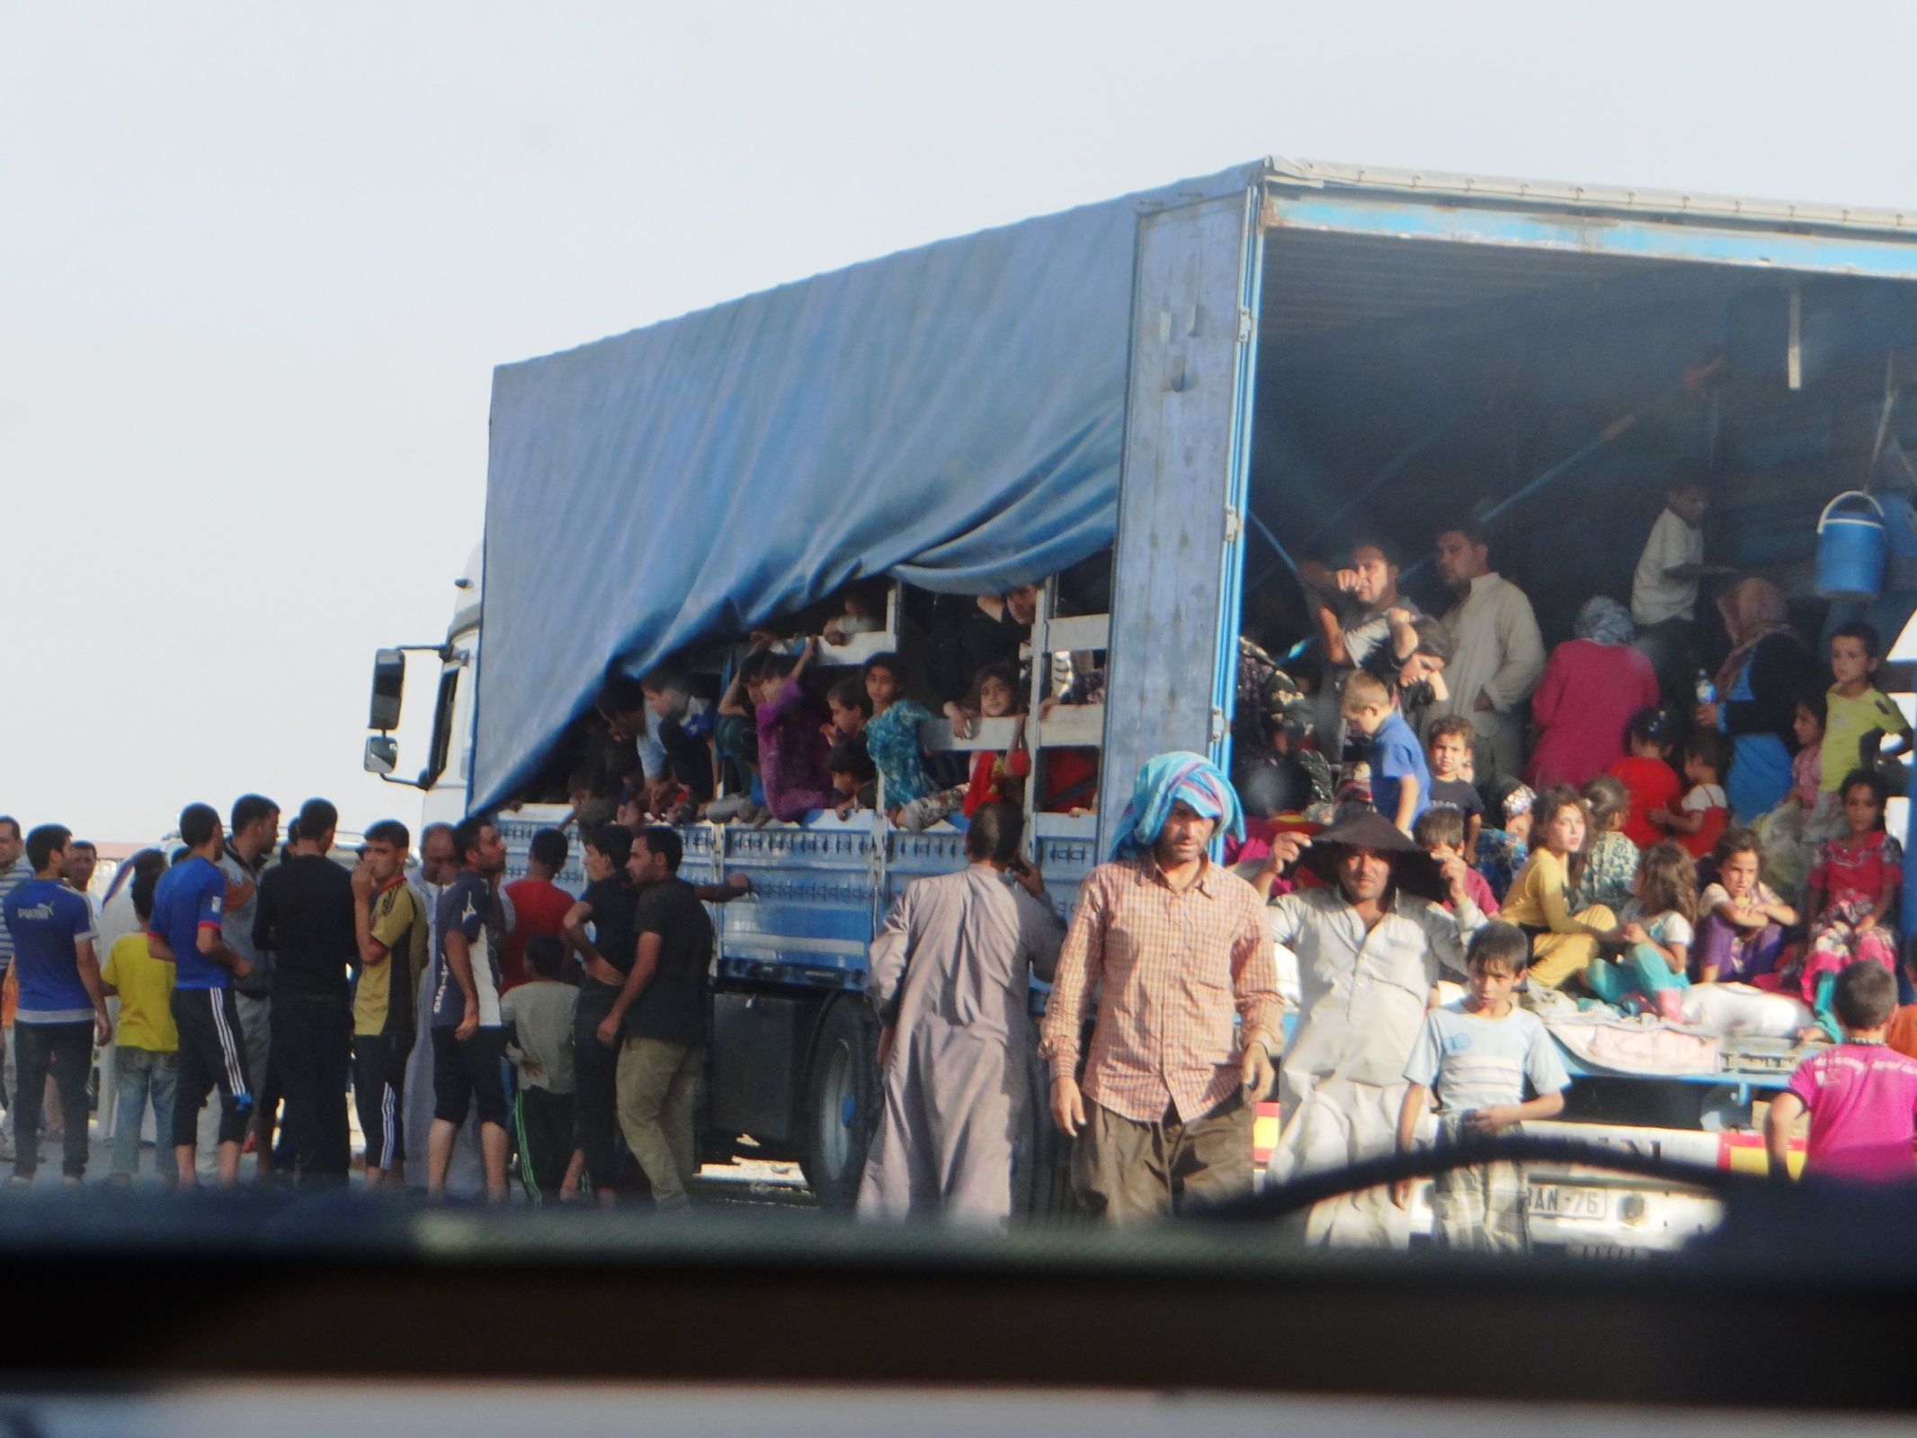
350,000 people displaced from Telafar alone

Slide 4
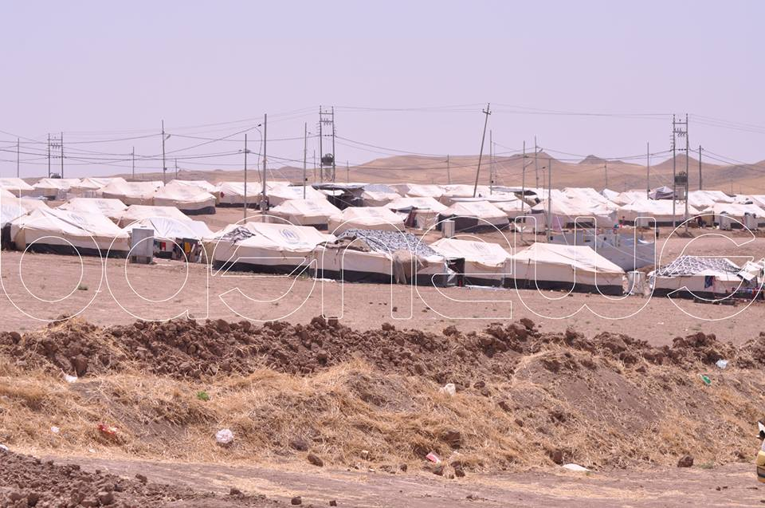
Refugee camp for Turkmens near Sinjar.
At least these people have somewhere to stay
Unlike some…

Slide 5
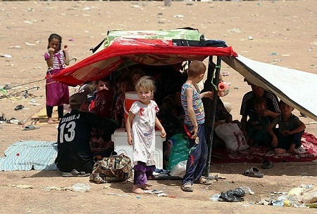
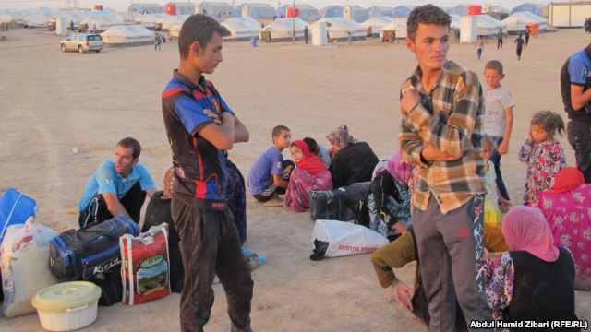
90,000 people in refugee camps
45,000 families displaced from Dyala

Slide 6
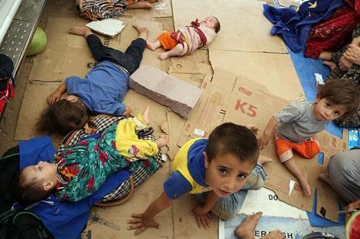
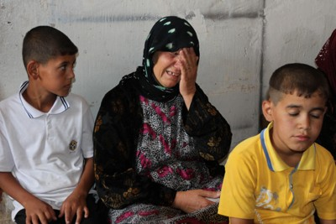
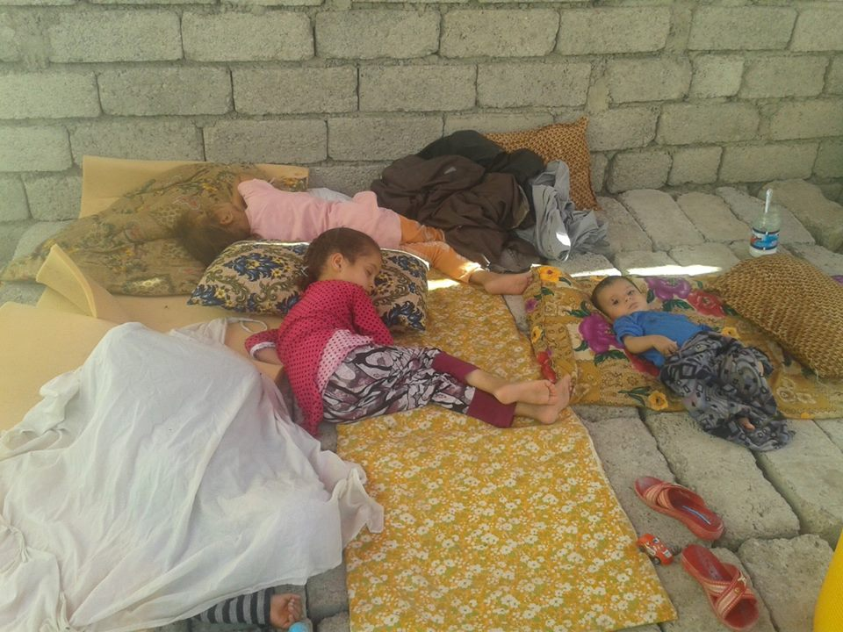
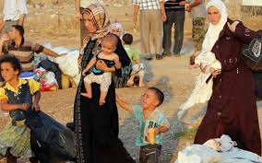
These women, children and families have been left homeless with no support.

Slide 7
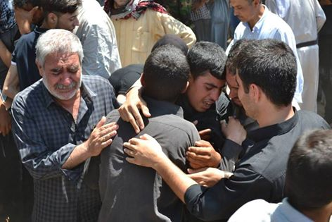
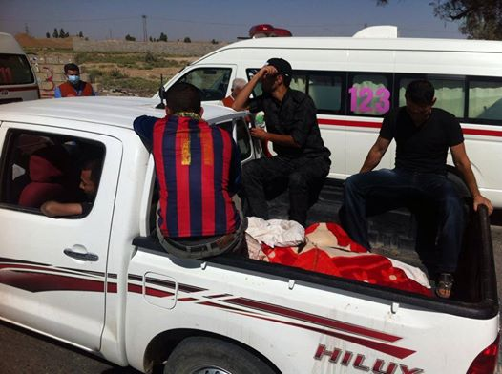
Turkmen bodies drenched in fresh blood being taken away by their communities as they flee their towns…
At least they had people to collect their body .
Unlike some…

Slide 8
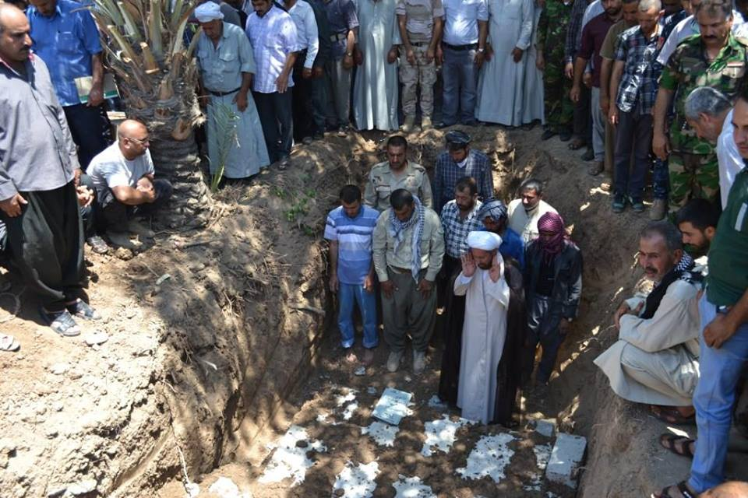
Burial for a group of martyrs slaughtered by ISIS in Beshir.
They had people to bury them.
Unlike some….

Slide 9
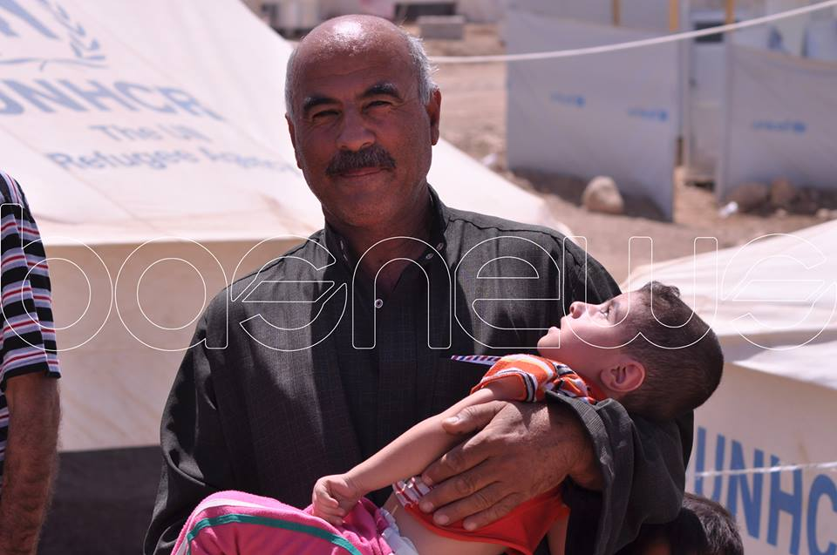
Father carrying his dead son in his arms…
He died of dehydration
Sufficient water-a simple life essential, a human right, has been deprived from these people.

Slide 10
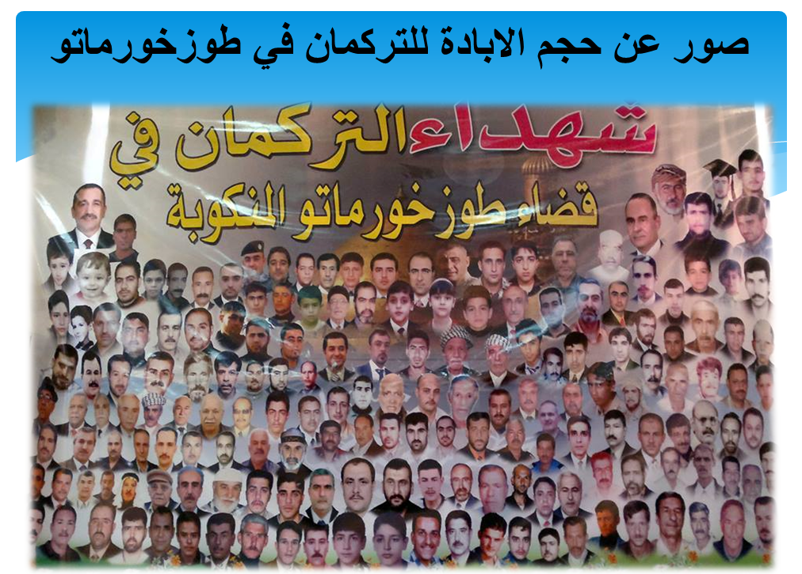
500 martyrs from Tuz alone in 2013/2014

Slide 11
This is the way our children have been treated…

Slide 12
Houses of innocent civilians in Tuz

Slide 13
Destruction of a primary school in Tuz

Slide 14
We have tried to help our people…
…but we need your urgent help

Slide 15
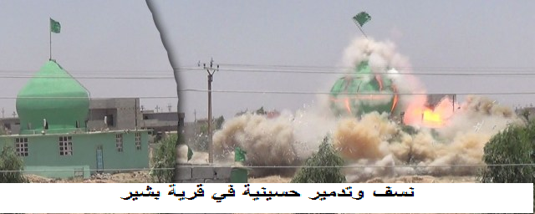
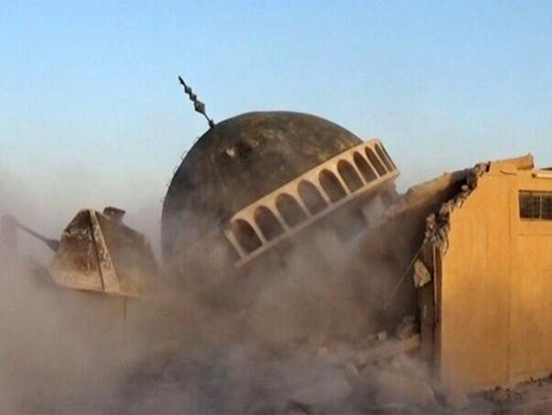
Turkmen Hussainy being attacked day after day…
Bombing of Hussainy in Bashir
Destruction of Ahmed al Raafi-visiting place
هدم ضريح ومزار "أحمد الرفاعي" في ناحية المحلبية

Slide 16
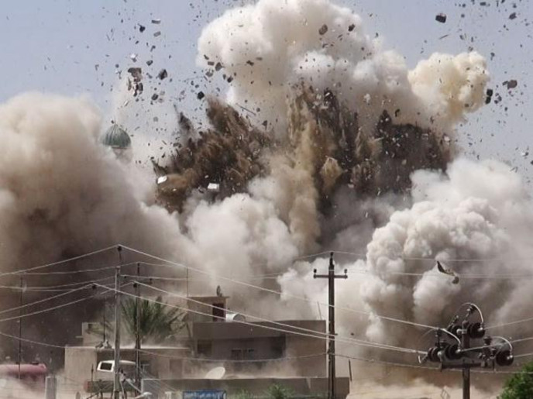
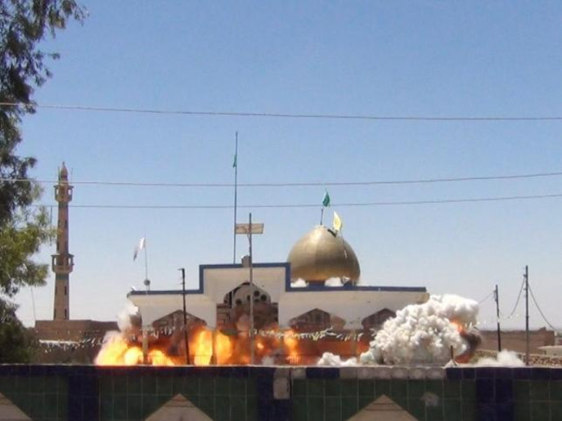
تفخيخ ونسف معبد "حسينية القبة" في الموصل
Explosion of Quba Hussainy in Mosul
تفخيخ ونسف معبد "حسينية سعد بن عقيل" في تلعفر
Explosion of Hussainy Saad bin Aqil in Telafer

Slide 17
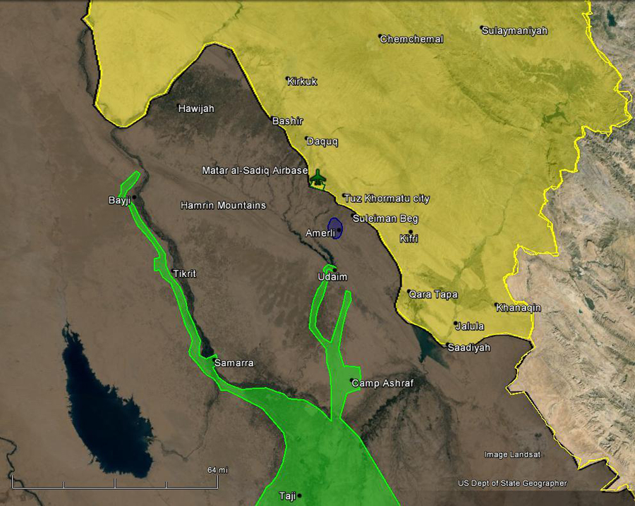
Amerli is struggling…
Blue on the map is Amerli – under the seige of ISIS since 17/06/14
They have no food, medicine and only limited water supply
Electricity has been cut off for the last 10 days
20,000 people need help!

Slide 18
Help save us. Say NO to Genocide.

Slide 19
Donations to…
Bank name: HSBC
Account name: Al-Ayn SCF
Account number: 51640763
Sort Code: 40-04-06
Reference: Relief / Turkman
www.relief.alayn.co.uk

