Slide 1
Summary of confiscation of the land and demographic changes of the Iraqi Turkmen region
Dr. Sheth Jerjis
Chairman
Iraqi Turkmen Human Rights Research Foundation
June 06, 2013
The forgotten Nation: Turkmens in Iraq

Slide 2
The Forgotten Nation: Turkmens in Iraq
June 6, 2013
11.00 – 13.00
Palais des Nation, Geneva
Switzerland
The forgotten Nation: Turkmens in Iraq

Slide 3
Executive Summary
Human Rights Situation
The Forgotten Nation: Turkmens in Iraq
Confiscation of the land
Demographic changes
The non-ruling Iraqi communities (minorities)
The forgotten Nation: Turkmens in Iraq

Slide 4
Topics of the presentation
Introduction
Population
Geography
Natural resources
Confiscation of land
Ba’ath regime (1968 – 2003)
Kerkuk province
Other Turkmen regions
Kurdish authorities (2003 – until now)
Kerkuk province
Other Turkmen regions
Demographic changes
Ba’ath regime (1968 – 2003)
Kerkuk province
Other Turkmen regions
Kurdish authorities (1968 – 2003)
Kerkuk province
Other Turkmen regions
The forgotten Nation: Turkmens in Iraq

Slide 5
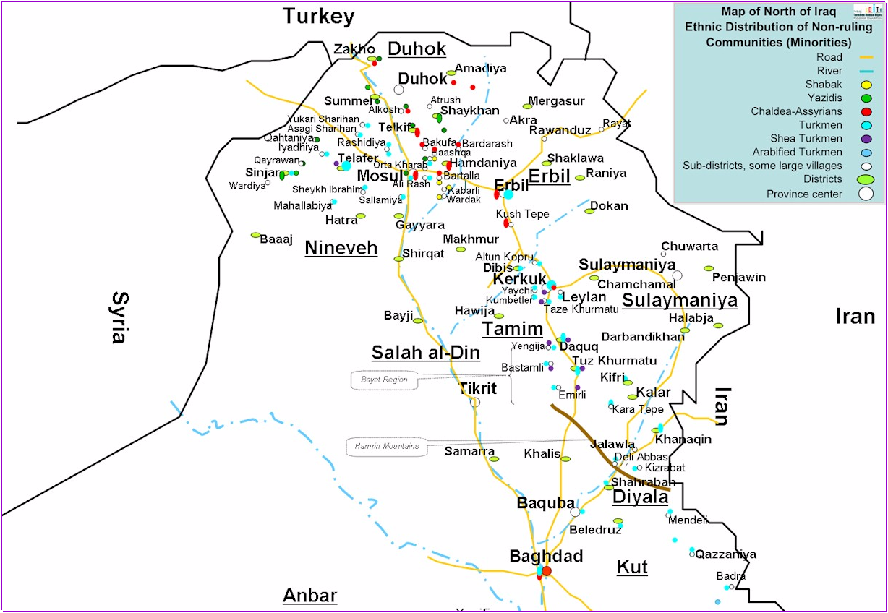

Slide 6
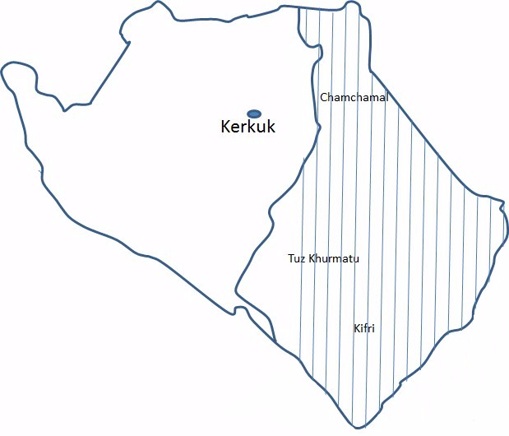

Slide 7
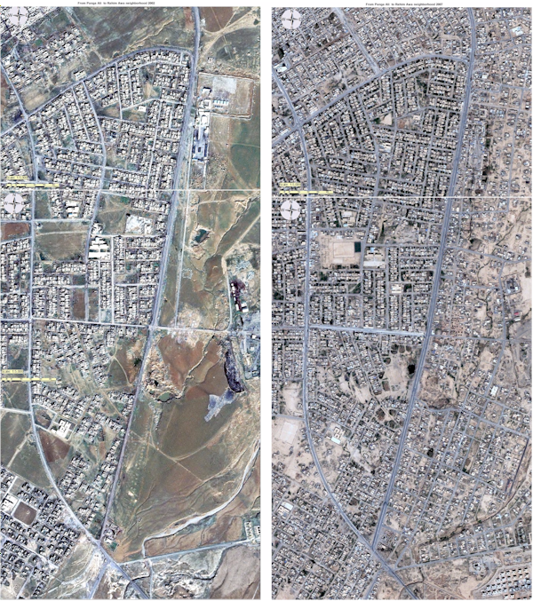
Satellite Map of Kerkuk province the Map of 2002 compared with the map of 2007

Slide 8
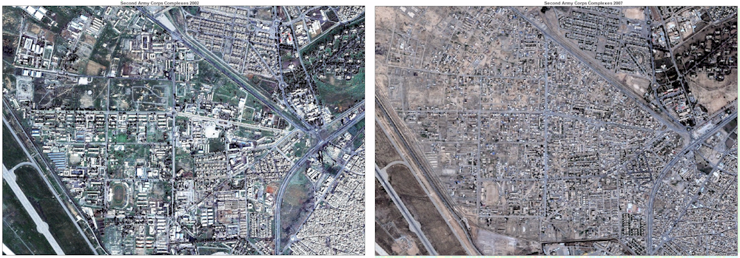
Kerkuk second Army complexes
Surface Area = 4.085.000 sqm
Satellite Map of Kerkuk province the Map of 2002 compared with the map of 2007

Slide 9
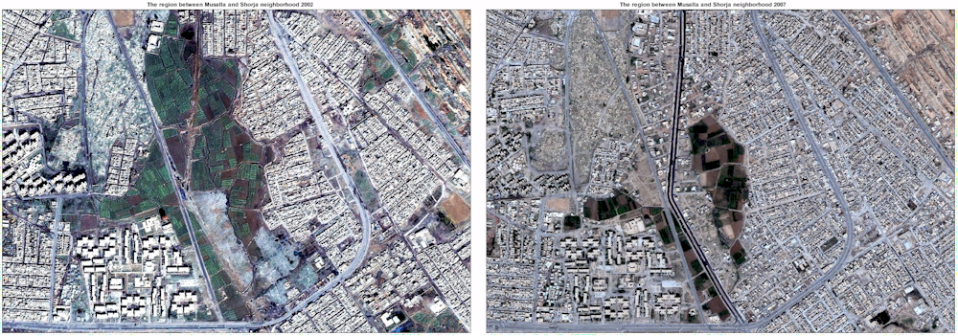
The region between Musalla and Shorja neighborhoods of Kerkuk city
Surface Area = 237.500 sqm
Satellite Map of Kerkuk province the Map of 2002 compared with the map of 2007

Slide 10
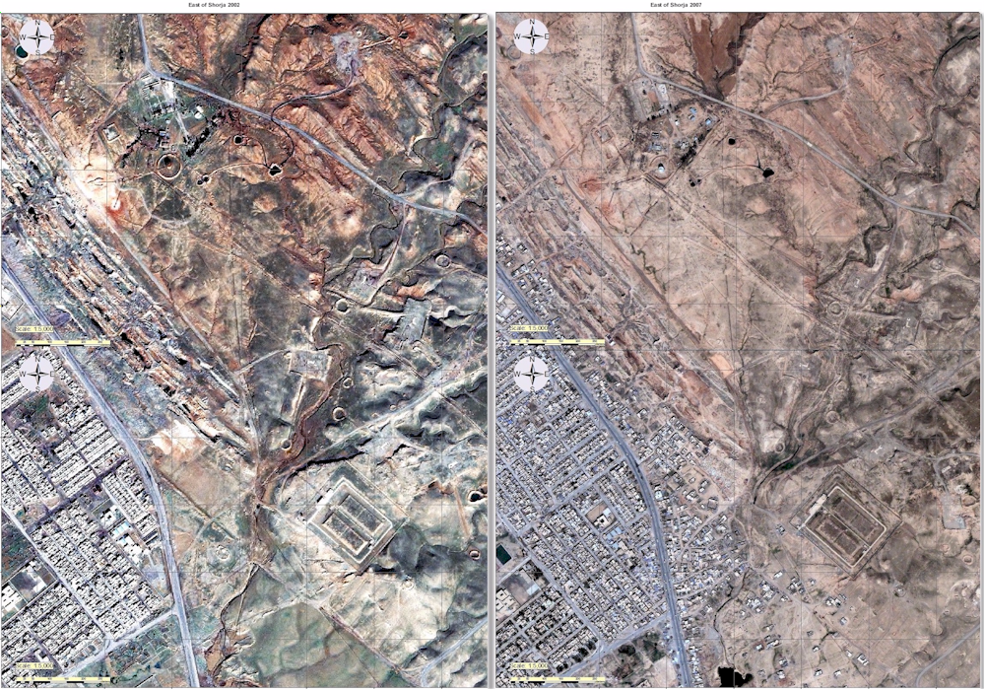
Satellite Map of Kerkuk province the Map of 2002 compared with the map of 2007

Slide 11
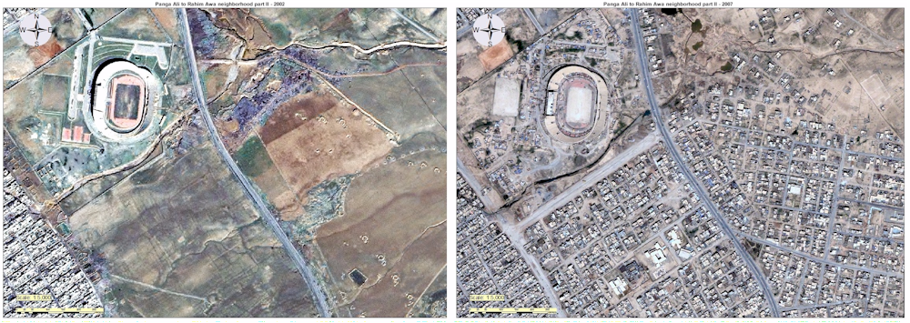
Satellite Map of Kerkuk province the Map of 2002 compared with the map of 2007

Slide 12
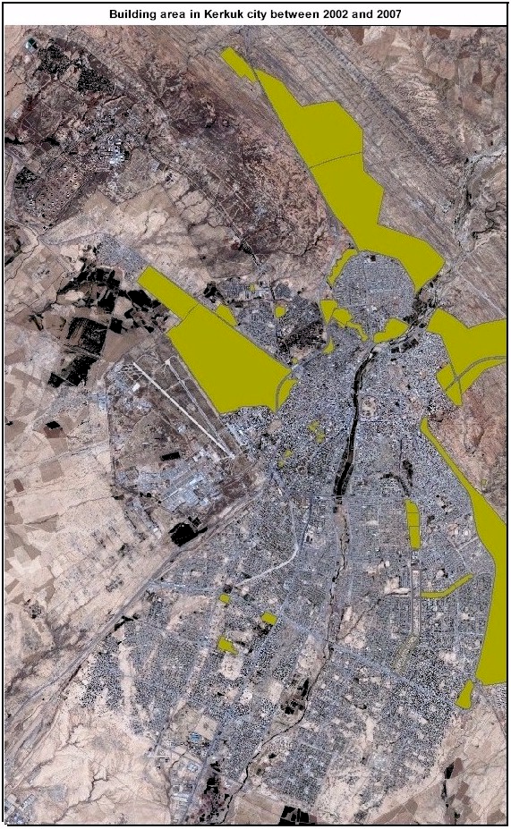
Satellite Map of Kerkuk province the Map of 2002 compared with the map of 2007

