Slide 1
The Present Situation of the Iraqi Turkmen
Dr. Sheth Jerjis
Chairman
Iraqi Turkmen Human Rights Research Foundation
June 20, 2013
Hearing of the Delegation for Relations with Iraq, The European parliament

Slide 2
the Situation of Ethnic Minorities and Religious Groups in Iraq
June 20, 2013
09.15 – 11.15
Room ASP A5E-2,
Altiero Spinelli buildingEuropean Parliament, Brussels
Hearing of the Delegation for Relations with Iraq, the European parliament

Slide 3
Executive Summary
Hearing of the Delegation for Relations with Iraq
Situation of Ethnic and Religious Groups in Iraq
The Situation of the Iraqi Turkmen
Hearing of the Delegation for Relations with Iraq, the European parliament

Slide 4
Topics of the presentation
Introduction
Population
Geography
Natural resources
Exposure to attacks
Kurdification of Turkmen region
Confiscated Turkmen lands
Marginalization in the administration
Others
Helplessness of the Turkmen
Conclusion
Hearing of the Delegation for Relations with Iraq, the European parliament

Slide 5
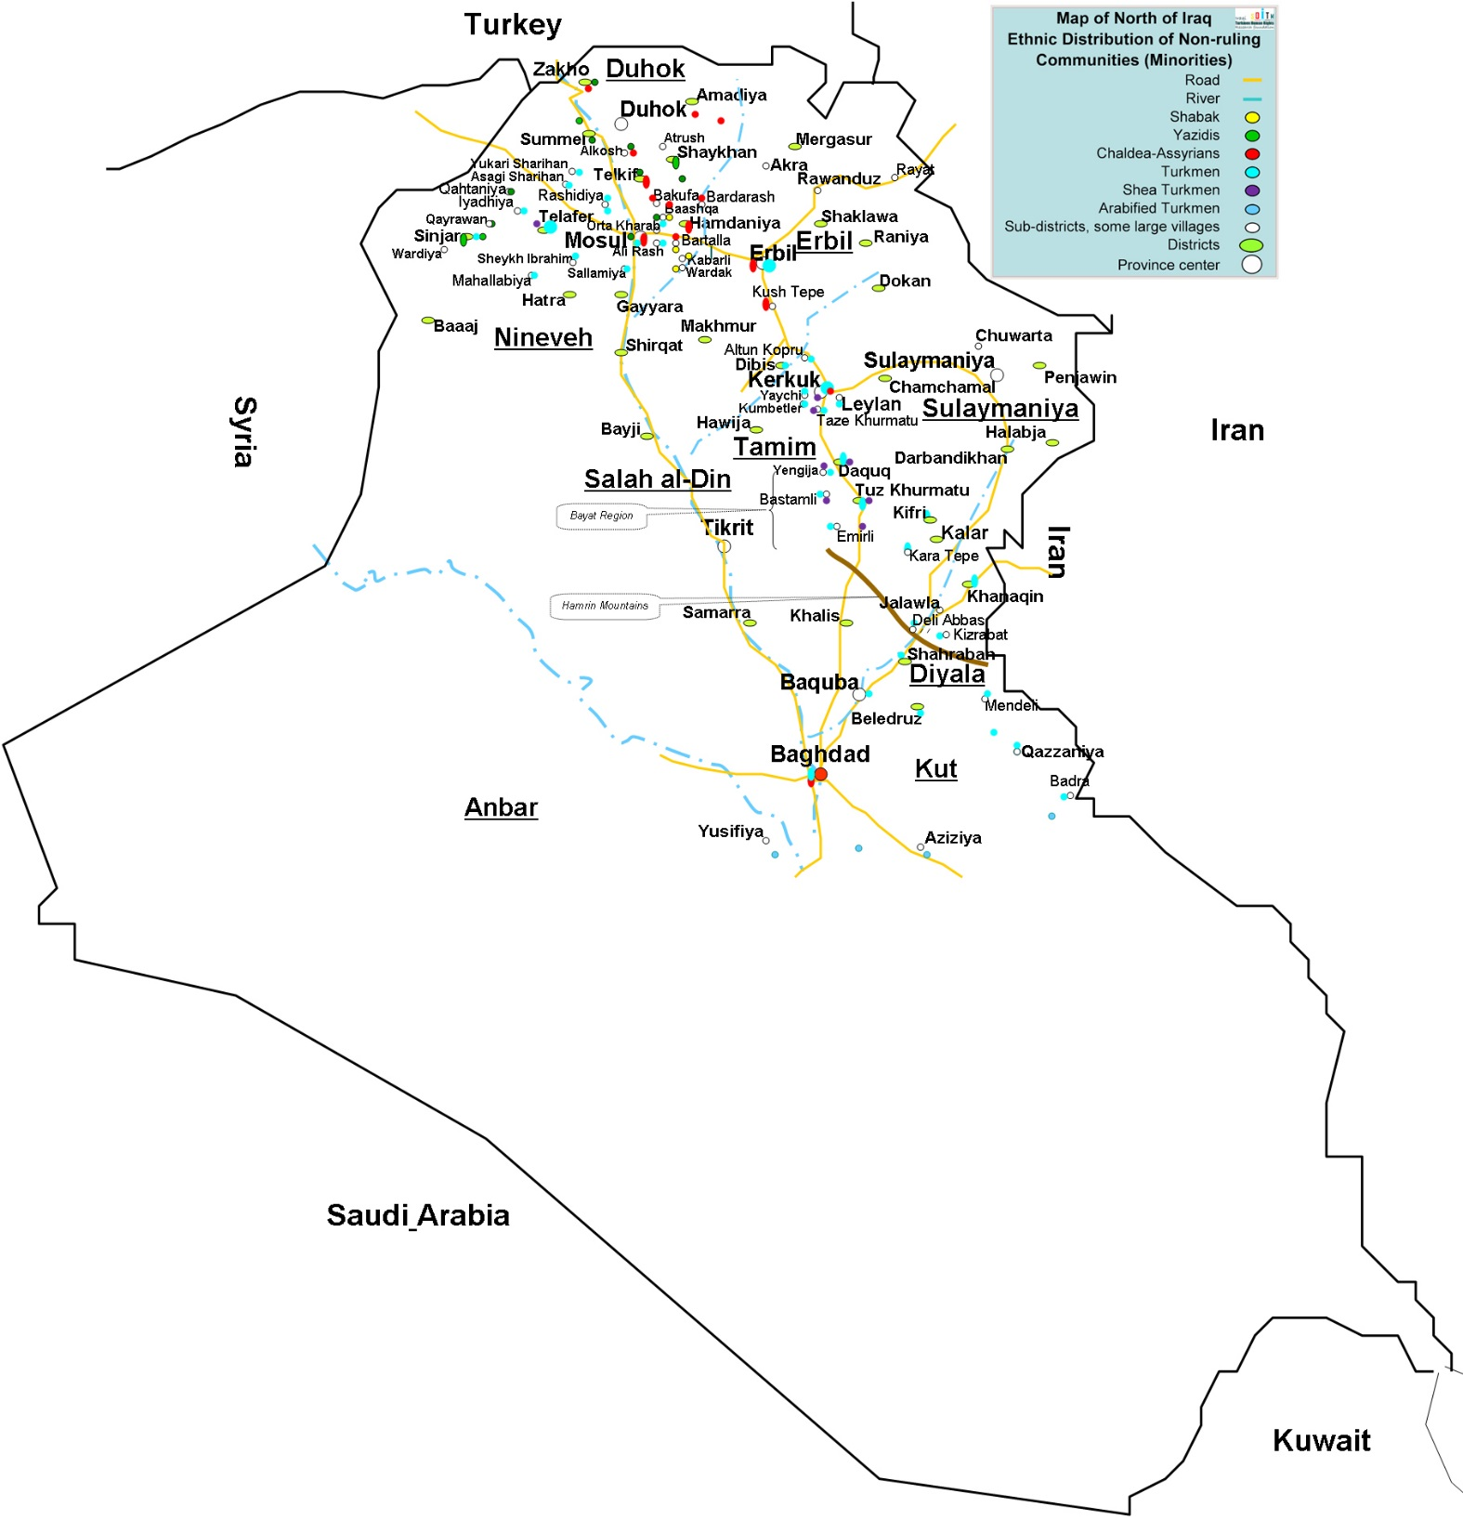

Slide 6
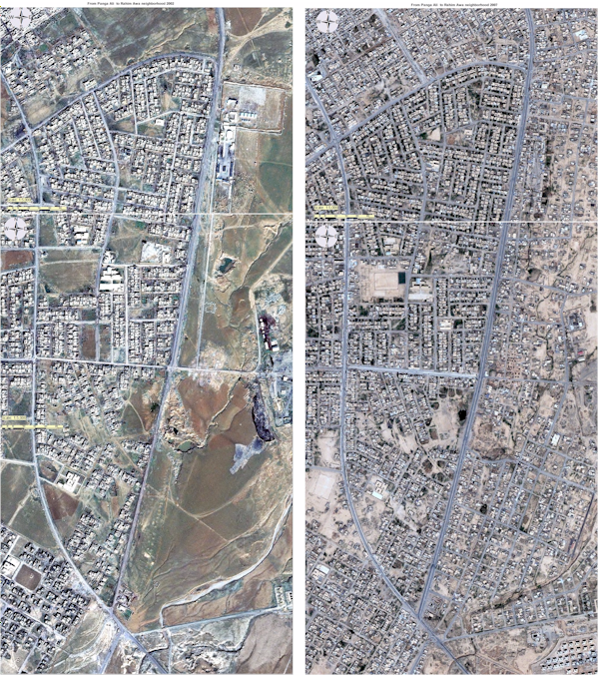
Satellite Map of Kerkuk province the Map of 2002 compared with the map of 2007

Slide 7
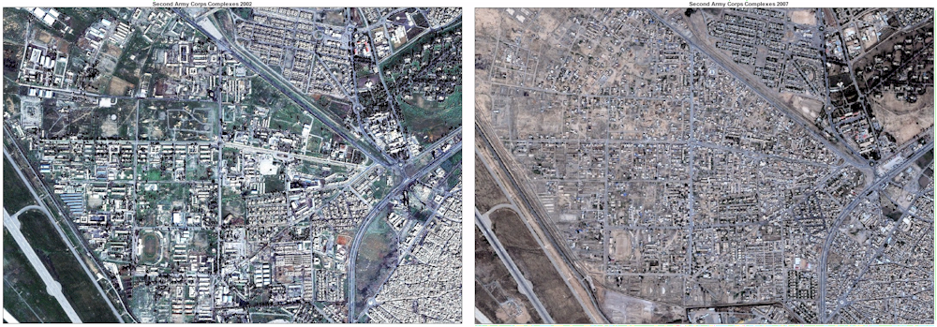
Kerkuk second Army complexes
Surface Area = 4.085.000 sqm
Satellite Map of Kerkuk province the Map of 2002 compared with the map of 2007

Slide 8
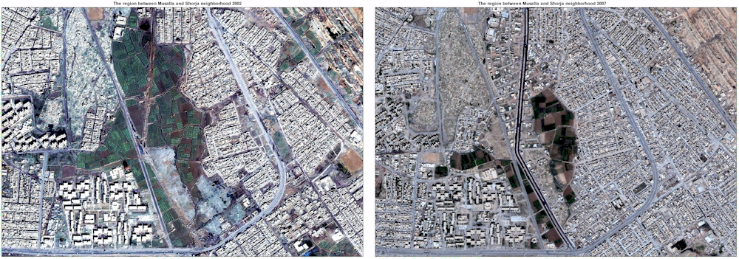
The region between Musalla and Shorja neighborhoods of Kerkuk city
Surface Area = 237.500 sqm
Satellite Map of Kerkuk province the Map of 2002 compared with the map of 2007

Slide 9
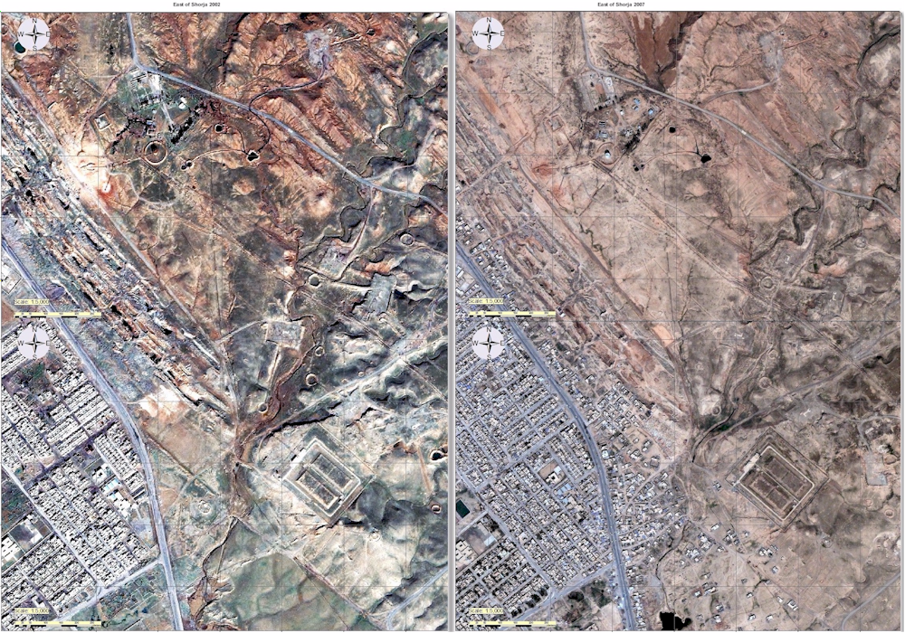
Satellite Map of Kerkuk province the Map of 2002 compared with the map of 2007

Slide 10
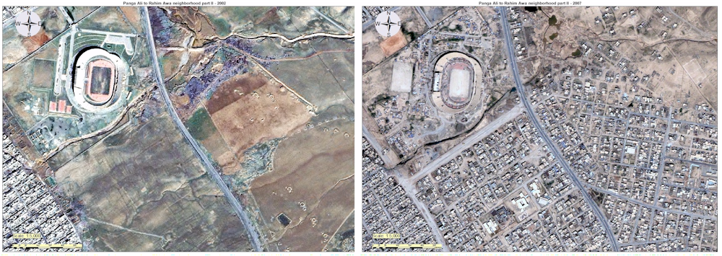
Satellite Map of Kerkuk province the Map of 2002 compared with the map of 2007

Slide 11
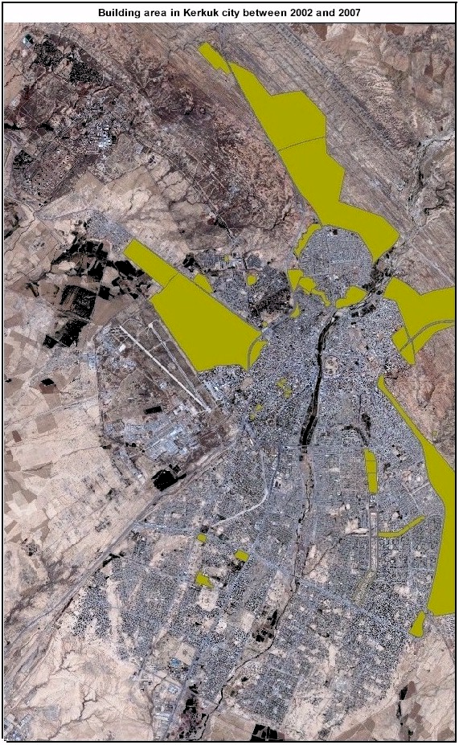
Yellow colour points to the lands which were built by between 2002 and 2007

